Slide 1
Housing Pricing Project

Slide 2
Contents
1. Questions & hypothesis
2. Approach and analysis
3. Correlation matrix
3. Q1. features of a house
5. Q2. amenities of a house
6. Q3. location of a house
7. Conclusion

Slide 3
Approach & Analysis
The project will involve:
Importing and cleaning the Housing Pricing Dataset.
Renaming columns for clarity and consistency.
Conducting exploratory data analysis to understand the distribution of prices and other features.
Using statistical models to assess the impact of various factors on housing prices.
Visualizing the findings to highlight key insights on what drives housing prices.
By analyzing these aspects, the Housing Pricing Project aims to provide valuable insights into the housing market, supporting better decision-making for stakeholders involved in real estate transactions.

Slide 4
Questions & Hypothesis
1. How do different features of a house (size, number of bedrooms/bathrooms, A/C, hot water heating, etc.) affect its price?
Hypothesis: larger area, higher number of bedrooms and bathrooms, and the presence of amenities like air conditioning positively influence the housing price.
2. Is there a significant difference in price based on the presence of furniture?
Hypothesis: the furnishing status of a house (furnished, semi-furnished, unfurnished) significantly impacts its sale price.
3. How do location-based attributes (being on a main road, in a preferred area) influence the housing price?
Hypothesis: houses in preferred areas and those with access to a main road command higher prices.

Slide 5
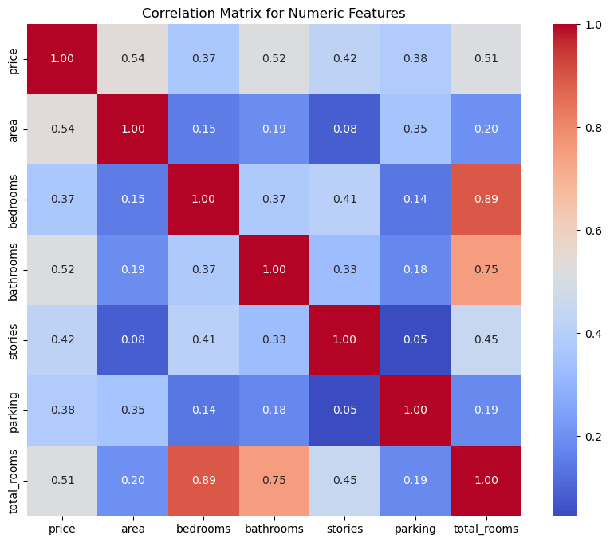
Correlation Matrix
Area and Price: A correlation coefficient of 0.536 suggests a moderate positive relationship between the area of the house and its price. Larger houses tend to be priced higher.
Bedrooms/Total Rooms and Price: Both bedrooms and total rooms have a positive correlation with price (0.366 and 0.512, respectively), indicating that more rooms generally correspond to a higher price.
Bathrooms and Price: With a correlation coefficient of 0.518, the number of bathrooms has a moderate positive correlation with price, suggesting houses with more bathrooms tend to be more expensive.)

Slide 6
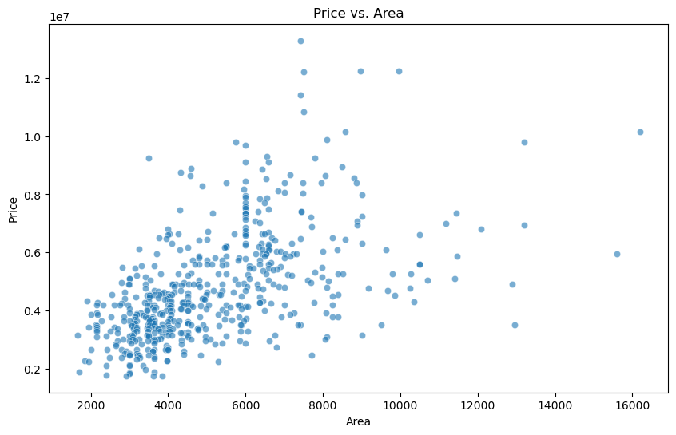
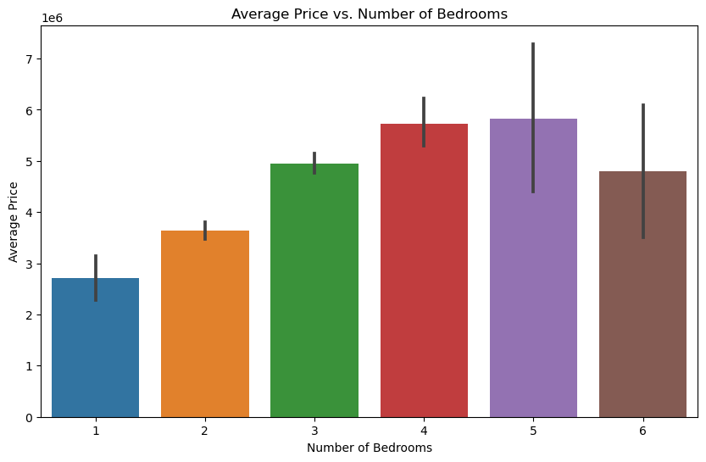
Q1. Features of a House
The analysis indicates a moderate positive correlation between property area and price, with 4-bedroom houses being the most expensive on average, though a variety of factors contribute to price variability and the diminishing value of homes larger than 4 bedrooms, underscoring the complexity of the housing market.

Slide 7
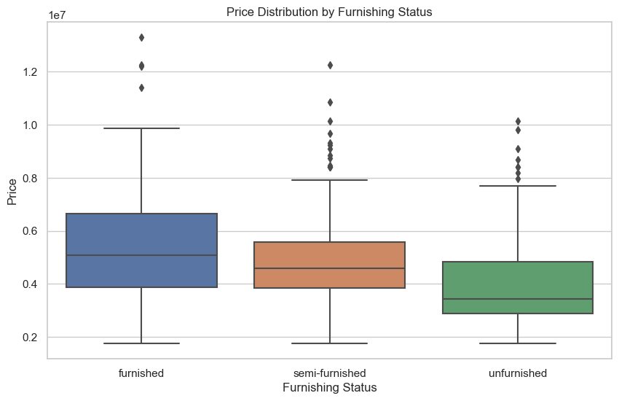
Q2. Amenities of a House
The analysis reveals that furnishing status significantly influences house prices, with furnished houses commanding the highest median prices, followed by semi-furnished, and unfurnished houses having the lowest, reflecting buyer preferences for either move-in readiness or the potential to customize according to their taste.

Slide 8
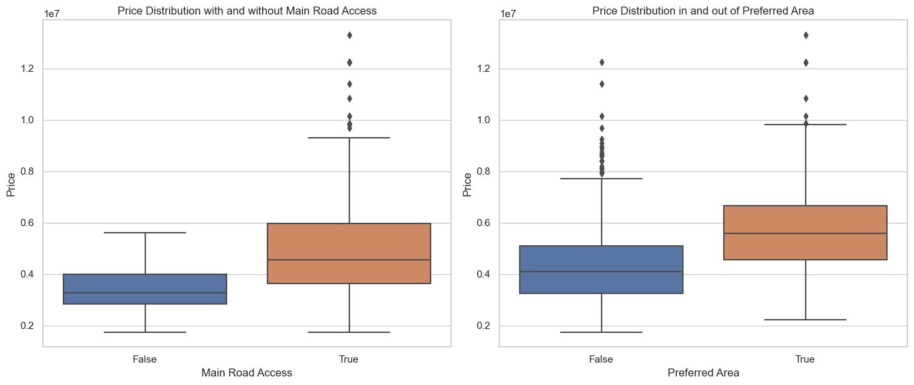
Q3. Location of a House
These insights indicate that both access to a main road and location in a preferred area are influential factors in house pricing, with houses in preferred areas or with main road access commanding higher median prices due to their highly valued attributes.

Slide 9
Results
1. How do different features of a house (size, number of bedrooms/bathrooms, etc.) affect its price?
The analysis reveals a moderate positive correlation between a property's area and its price, indicating that while larger areas tend to command higher prices, other factors also significantly influence property values, as evidenced by the variability in prices within similar area ranges. Additionally, 4-bedroom houses emerge as the most expensive on average, suggesting their high demand or additional desirable features, though the price variability and the observed price decrease in homes with more than 4 bedrooms highlight the complex dynamics affecting house prices.
2. Is there a significant difference in price based on the presence of certain amenities (air conditioning, hot water heating, etc.)?
The presence of amenities like air conditioning and hot water heating significantly influences housing prices, with both amenities leading to higher median prices and suggesting their valued contribution to property appeal.
3. How do location-based attributes (being on a main road, in a preferred area) influence the housing price?
Location-based attributes such as having main road access and being in a preferred area significantly influence housing prices, with properties in these categories commanding higher median prices due to their highly valued nature.

